Slide 1
Prediction of Financial Loss Impact Patterns of Tornadoes
Team 8
Swetha Mohan and Anupama Garani

Slide 2
Agenda
Introduction
Problem Statement
Objectives
Related Works
Data Set
Methodology
Results
Demo
Conclusions and Future Work

Slide 3
Introduction
The effects of global warming have resulted in drastic changes to the climate of Earth and every year the number of natural calamities such as tornadoes, drought, floods has been constantly increasing
The extreme weather conditions always result in huge financial and human losses
Natural disasters have resulted in $145 billion in losses for the past decade alone

Slide 4
Introduction
Difference between tornado and hurricane
69% of tornadoes that occur each year belongs to “Weak” category and accounts for 5% of tornado deaths
Difficult to predict exactly where tornadoes will occur but we predict the states where the probability of intense tornadoes is greatest
Due to urbanization, the chances of tornadoes damaging properties of urban, sub-urban and surrounding areas have increased
Notes:
Hurricanes – large scale storm that may range in diameter from 100 – 1000 miles. Hurricanes generally occur in oceans and they rarely hit lands due to difference of high wind pressure in atmosphere
Tornados diameter ranges from 1.5 miles, shorter in length. Wind speed can range from 60 to 320 mph hence causes more damage than hurricane

Slide 5
Problem Statement
With the advent of visual analytics tools and data sets from the government website, the effectiveness of tornado warnings has significantly improved
Visual analytics tools and spatio temporal analysis through Geographic Information Systems (GIS) could be effectively used to study the behavior of tornadoes
Patterns and relationships by tornado characteristics and how the magnitude, hail inches and wind speed of tornadoes have a direct impact on the financial loss of a state should be analyzed
Aim is to understand the geography covered by the tornadoes, the infrastructure and agricultural damages caused by it and to make predictions on financial losses and magnitude of tornadoes

Slide 6
Objectives
Identify the relationship between the width of the tornadoes based on the distance traveled and the magnitude of the tornadoes
Predict the pattern between the wind speed at a geographic location and the financial losses incurred by it over a period of time
Identify the geographic locations which has experienced maximum tornadoes over a certain period of time frame
Explore the pattern between the geographic location covered by the tornadoes based on their terrain type and how does it affect the magnitude of the tornadoes
Categorize the geographic locations that has suffered maximum losses over the same period of time considered based on the magnitude of tornadoes

Slide 7
Related Works
A study of GIS tools available during tornado events [1]
Meteorological information when combined with GIS becomes extremely powerful to view impacted areas
A seamless way to create accurate damage path will help officials to coordinate resources in a timely manner
ArcGIS based visualization tool for assessment of earthquakes impact [2]
Analyses the impact of biggest earthquakes happened between 2010-2015 based on ArcGIS maps
Concluded that urban areas face high risk from hazards due to the degree of infrastructure vulnerability

Slide 8
Data Set
The dataset “Storm Prediction Center” is obtained from Kaggle website and contains 60,115 records
Created by National Weather Service and includes real tornado activity between 1950 to 2015 in the CSV format
Contains attributes,
Date and Time
State and State Number
Magnitude
Injuries
Fatalities
Financial loss and Crop loss
Latitude and Longitude
Length and Width
Notes:
Magnitude in Fujita scale. F3 F4 F5 represents high to severe tornados
Loss in millions of dollars
Latitude and Logitute in decimal degress
Length in miles, width in yards

Slide 9
Methodology
Perform data cleansing on the data set, analyzing the attributes and remove fields which are not required for our analysis
Preprocess the data to generate a data set that can be used for further processing
Analyze the data set by using Tableau, ESRI ArcMaps and Power BI and study the relationships between geography of the state, width of the tornados, magnitude, the infrastructure affected by each tornado in different states
Validate the effectiveness of our findings by comparing the predictions with the recent tornados and financial losses

Slide 10
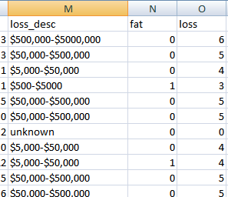
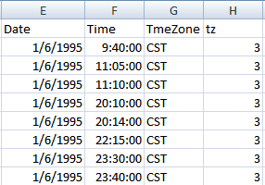
Snapshots of cleaned data

Slide 11

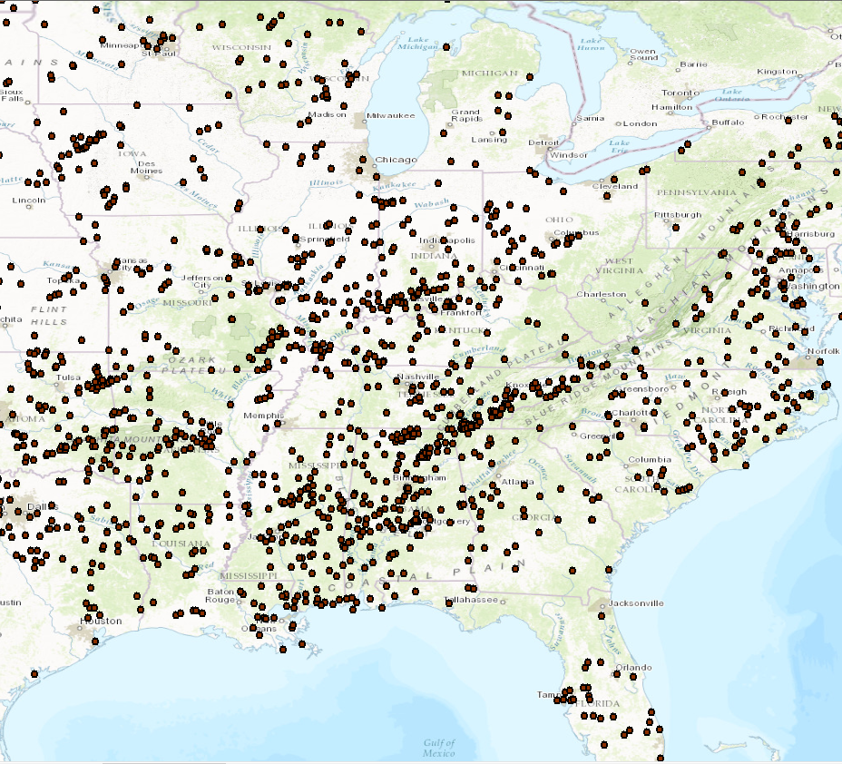
Results
After cleaning plotted the entire data in tropical map to see the distribution
On a broader analysis, the count of tornadoes seems to be higher in the mid west and southern regions of USA

Slide 12
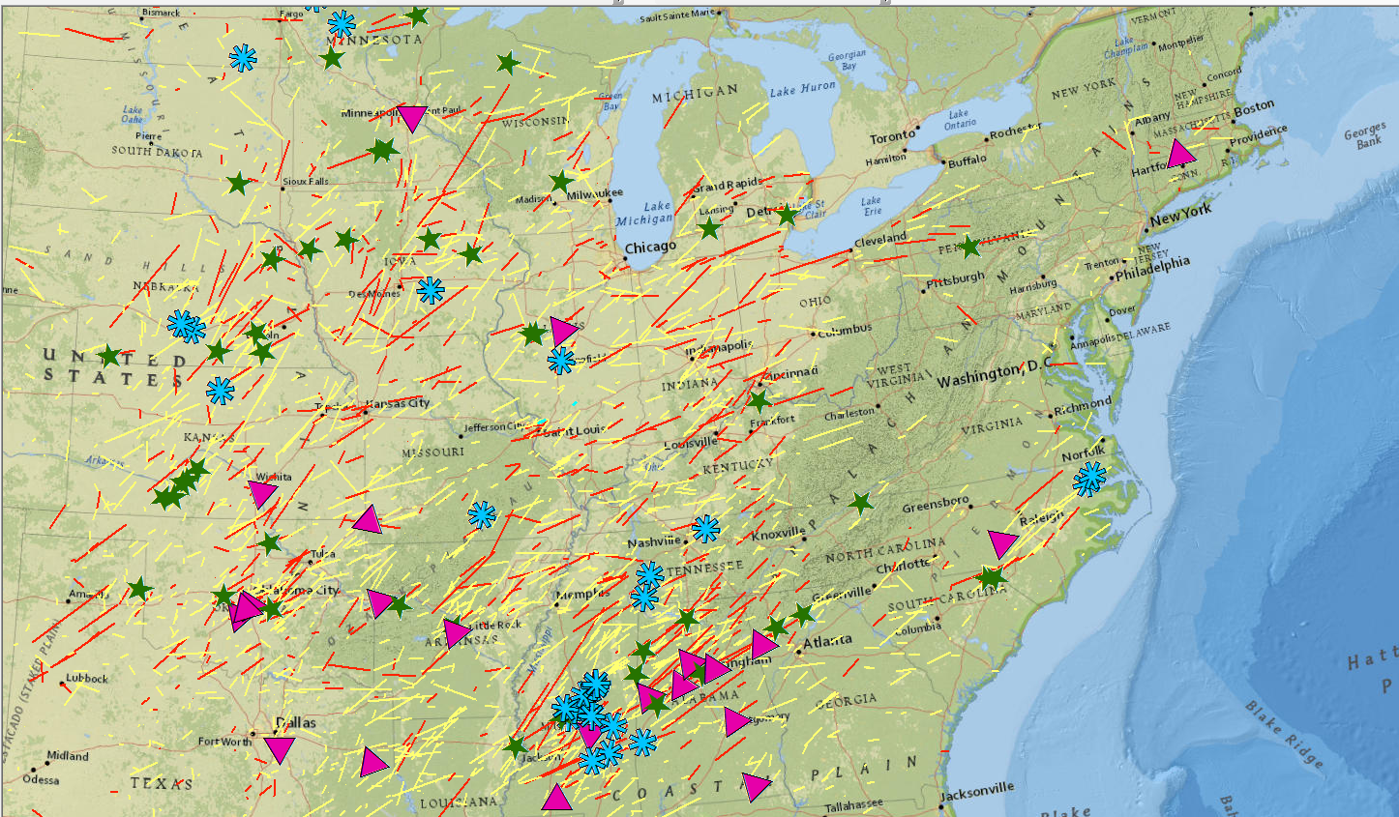
Results
Analyzed the data for magnitudes greater than 3 Fujita Scale
Tornados with more than one mile width (2000 yards) and length more than 50 miles
Identified patterns between above and when loss is more than one million

Slide 13
Demo

Slide 14
Conclusions and Future Work
We intend to work on this prediction model using classification algorithms in Weka and using python which can predict patterns for future
A real time system which gets data everyday from National Weather Service and Storm Prediction Center and generate results
States – Alabama, Mississippi, Indiana, Oklahoma, Kansas and Georgia are always the worst affected in terms of magnitude and loss and hence measures have to be taken in future
Deadliest tornado year – 2011. 1995, 1998, 2011 witnessed more number of tornados

Slide 15
References
[1] Hubbard, S., & MacLaughlin, K. (2006, July). A Study of the GIS Tools Available During Tornado Events and Their Effectiveness for Meteorologists, First Responders and Emergency Managers. In 12th Conference on Cloud Physics.
[2] Boruff, B, Easoz, JA, Jones, SD, Landry, HR, Mitchem, JD & Cutter, SL 2003, 'Tornado hazards in the United States' Climate research, vol 24, no. 2, pp. 103-117. DOI: 10.3354/cr024103
[3] T. Gula, C. Grosu, D. Nanuti, M. Mocanu and S. N. Ciolofan, "ArcGIS Based Visualization Tool for Assessment of Earthquakes Impact," 2015 Ninth International Conference on Complex, Intelligent, and Software Intensive Systems, Blumenau, 2015, pp. 308-313
[4] Cannon, Amber. "Deriving Population Exposure Fatality Rate Estimates for Tornado Outbreaks Using Geographic Information Systems (GIS)" Paper presented at the annual meeting of the Oklahoma Research Day, Cameron University, Lawton, OK, Nov 04, 2011
[5] Donner, W. R., “The political ecology of a disaster: An analysis of factors influencing U.S. tornado fatalities and injuries, 1998-2000,” 2007 Demography, 2007, 44(3), 669-685
[6] Brenner SA, Noji EK, “Tornado injuries related to housing in the Plainfield Tornado,” Int J Epidemiol 24:144–149

Slide 16
Any questions ?
Thank you!

